Slide 1
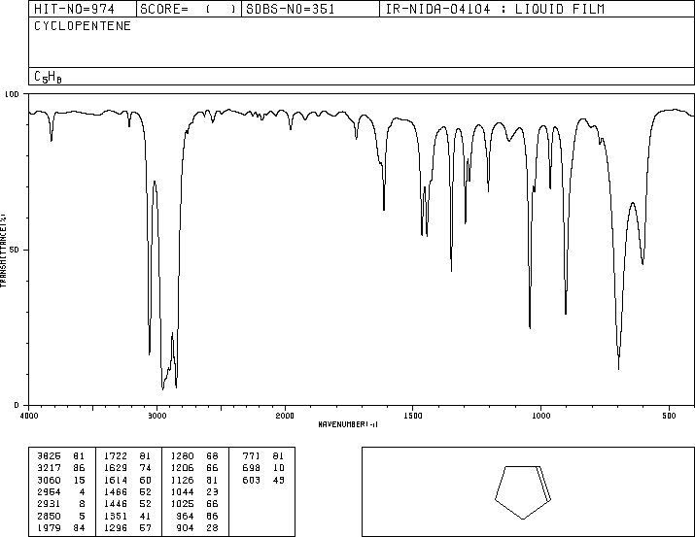
IR: ethanol, pentanal, ethanoic acid, ethene, ethanamine,

Slide 2
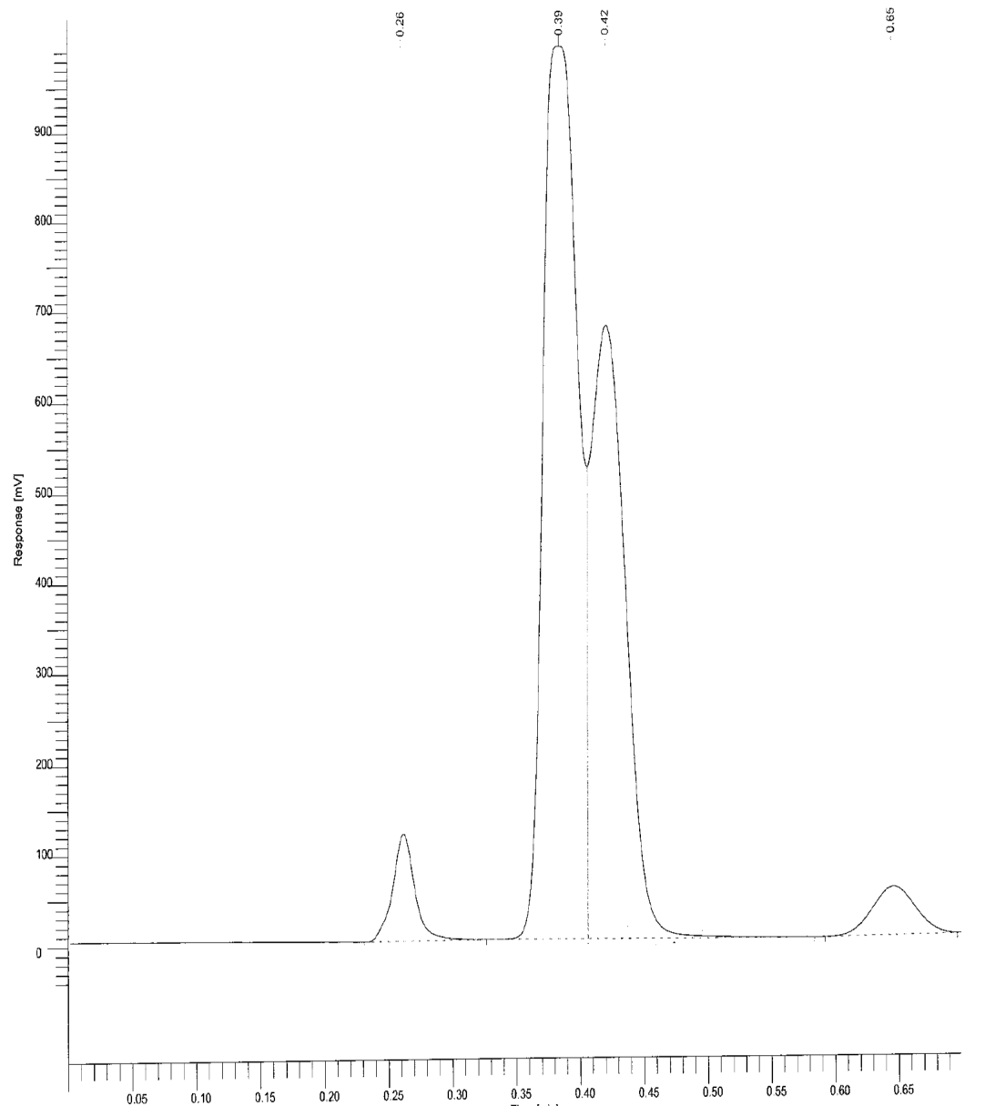
GC: 1. How many products? 2. Which peak has the highest BP? 3. Which is the major product? 4. Which has the lowest retention time?
2
3
1
4

