Slide 1
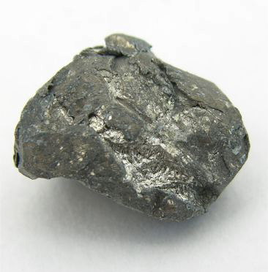
Calcium
Renee Y. Becker
CHM 1025
July 6, 2010

Slide 2
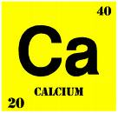
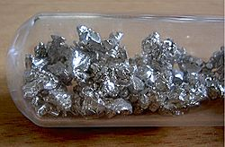
Elemental symbol: Ca
State: Soft, gray metal
Atomic number: 20
Number electrons
Number protons
Atomic mass: 40.078 amu
Number neutrons
Density = 1.55 g/cm³
Lightest of the alkali earth metals

Slide 3
Fifth most abundant element
By mass in the Earth's crust
Dissolved ion in seawater
By mass in the human body
Calcium is essential for living organisms
Cell physiology, where movement of the calcium ion Ca²⁺ into and out of the cytoplasm functions as a signal for many cellular processes

Slide 4
Isotopes of Calcium
Calcium has six isotopes
⁴⁰Ca ⁴⁴Ca
⁴²Ca ⁴⁶Ca
⁴³Ca ⁴⁸Ca

Slide 5
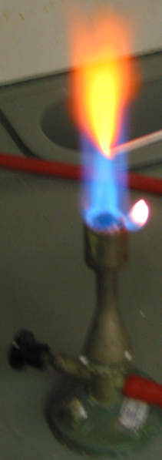
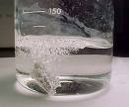
Difficult to ignite, unlike magnesium, but when lit, the metal burns in air with a brilliant high-intensity red light.
Calcium metal reacts with water, evolving hydrogen gas at a rate rapid enough to be noticeable, but not fast enough at room temperature to generate much heat

Slide 6
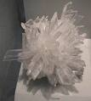
Where do we find Calcium?
Calcium is not naturally found in its elemental state
Sedimentary rocks
Calcite
Dolomite
Gypsum

Slide 7
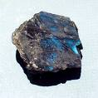
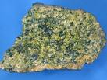
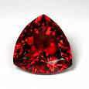
Where do we find Calcium?
Igneous and metamorphic rocks
Plagioclase Pyroxenes
Amphiboles garnets

Slide 8
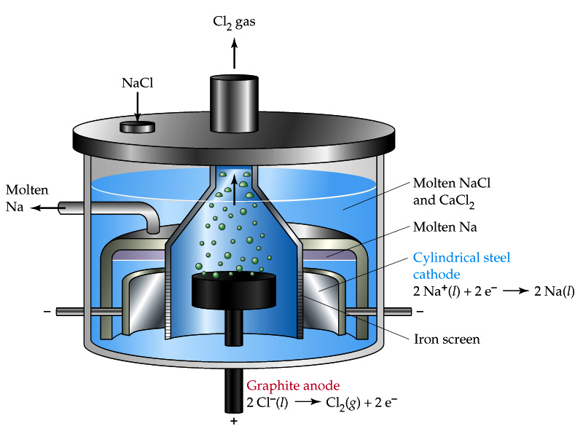
Industrial Calcium Production
Extracted by electrolysis from a fused salt like calcium chloride
Electrolysis: method of using an electric current to drive an otherwise non-spontaneous chemical reaction.

Slide 9
Small Scale Calcium Production
Calcium can be made through the reduction of CaO with aluminium or of CaCl₂ with sodium metal
6CaO + 2Al→ 3Ca + Ca₃Al₂O₆
CaCl₂ + 2Na→ Ca + 2NaCl

Slide 10
History
Calcium (Latin word calcis meaning "lime")
First century when the Ancient Romans prepared lime as calcium oxide
975 AD plaster of paris (calcium sulphate), is useful for setting broken bones
Isolated in 1808 in England
Sir Humphry Davy electrolyzed a mixture of lime and mercuric oxide
Calcium metal was not available in large scale until the beginning of the 20th century.

Slide 11
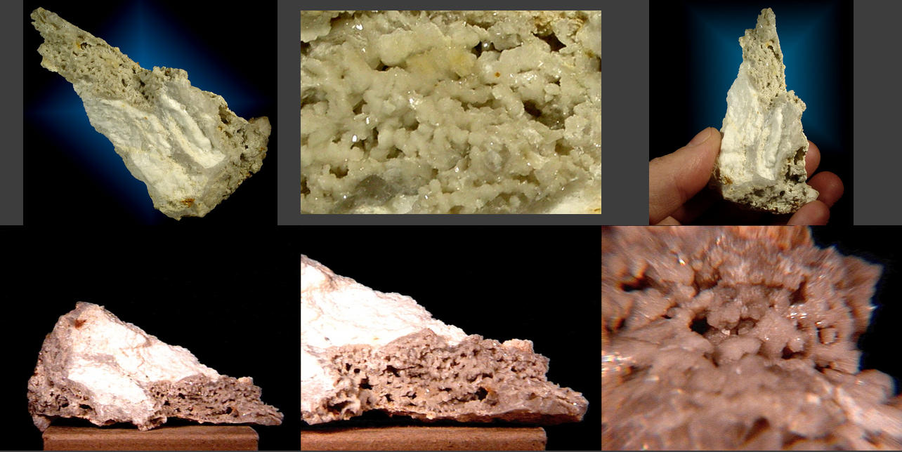
Calcium Compounds
Calcium, combined with phosphate to form hydroxylapatite, is the mineral portion of human and animal bones and teeth

Slide 12
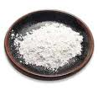
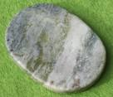
Calcium Compounds
Calcium carbonate (CaCO₃) is one of the common compounds of calcium. It is heated to form quicklime (CaO), which is then added to water (H₂O). This forms another material known as slaked lime (Ca(OH)₂), which is an inexpensive base material used throughout the chemical industry. Chalk, marble, and limestone are all forms of calcium carbonate.

Slide 13
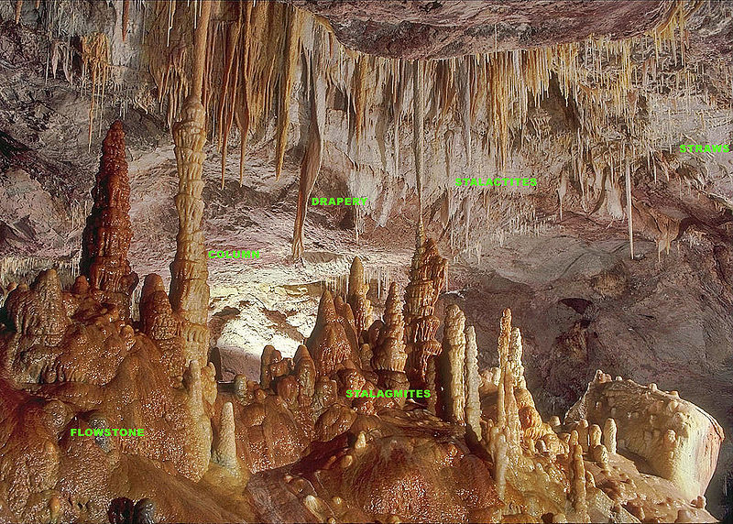
When water percolates through limestone or other soluble carbonate rocks, it partially dissolves the rock and causes cave formation and characteristic stalactites and stalagmites and also forms hard water.

Slide 14
References
Mla format OK, whatever you are using in english class
You can use internet sources but use at least 1 book

Slide 15
Acknowledgements
Lab Partner 1
Lab Partner 2
Professor

