Slide 1
Logging in to Enhanced WebAssign
Use Your Required Materials and Own Your Grade

Slide 2
Enhanced WebAssign
Allows you to complete required online homework assignments.
Provides you with immediate feedback.
Helps you stay on track with the course.
Includes rich, tutorial content to aid in concept mastery.
Provides access to a digital version of your textbook (or relevant textbook passages).
Will help you to succeed in this course.
Notes:
Enhanced WebAssign
Allows you to complete required online homework assignments.
Provides you with immediate feedback.
Helps you stay on track with the course.
Includes rich, tutorial content to aid in concept mastery.
Provides access to a digital version of your textbook (or relevant textbook passages).
Will help you to succeed in this course.

Slide 3
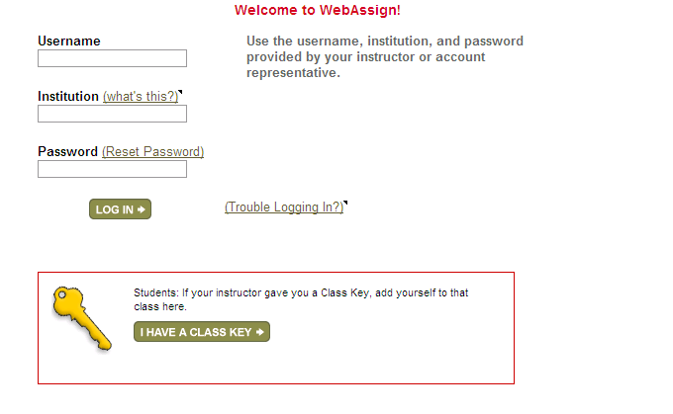
So, how do I login?
Go to the Login page at http://webassign.net/login.html
Ignore the above part for now. Enter the class key found in the syllabus
Notes:
Go to the Login page at http://webassign.net/login.html and click I Have a Class Key.

Slide 4
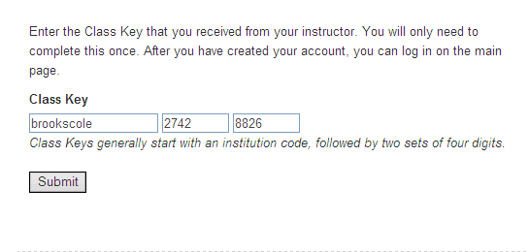
Your Class Key is:
Enter your Class Key
Notes:
Enter the Class Key that you received from your instructor and click Submit.

Slide 5
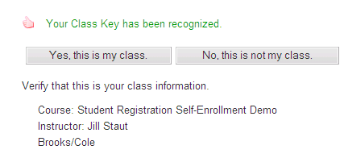
You’ll receive confirmation that your class key has been recognized. Click Yes, this is my class.
Confirmation
Notes:
You’ll receive confirmation that your class key has been recognized. Click Yes, this is my class.

Slide 6
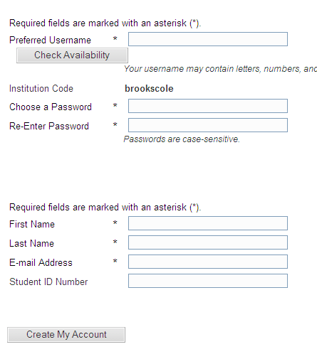
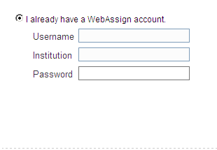
Create Account or login to an Existing Account
Create a New WebAssign Account
Login to an Existing WebAssign Account
Notes:
You’ll receive confirmation that your class key has been recognized. Click Yes, this is my class.

Slide 7
How Do I Pay for WebAssign?
After creating and account or logging in, you will see a notice that shows Payment Options:
To register, enter your access code if you have an access code card.
If you do not have an Access Code card, you can buy an Access Code online with a credit card or using a PayPal account.
You can also enter the course under a trial period.
After the Grace Period ends, you must enter an Access Code to continue working assignments and accessing your grades.
Notes:
After creating and account or logging in, you will see a notice that shows Payment Options:
To register, enter your access code if you have an access code card.
If you do not have an Access Code card, you can buy an Access Code online with a credit card or using a PayPal account.
You can also enter the course under a trial period.
After the Grace Period ends, you must enter an Access Code to continue working assignments and accessing your grades.

Slide 8
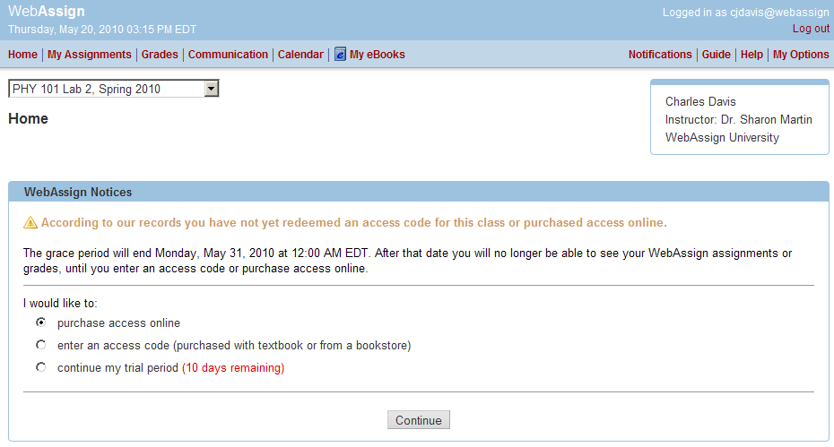
Payment/Code Registration Screen
Notes:
This page illustrates the three options students have to access EWA.
Purchase an access code online from EWA
Enter the Access Code they received with their textbook or separately from the bookstore
Continue with a trial period that runs for 14 days class start date (as defined by the instructor in EWA)

Slide 9
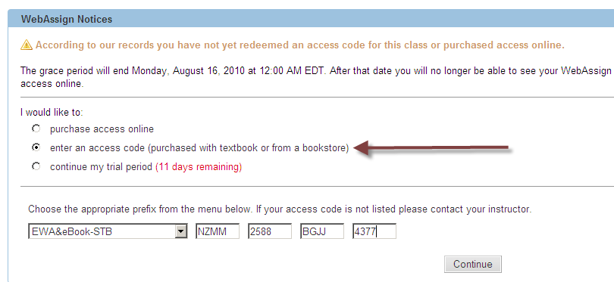
Entering your Access Code
Notes:
Choose Enter an Access Code. Enter the code as it appears in your access code package and then Click Continue

Slide 10
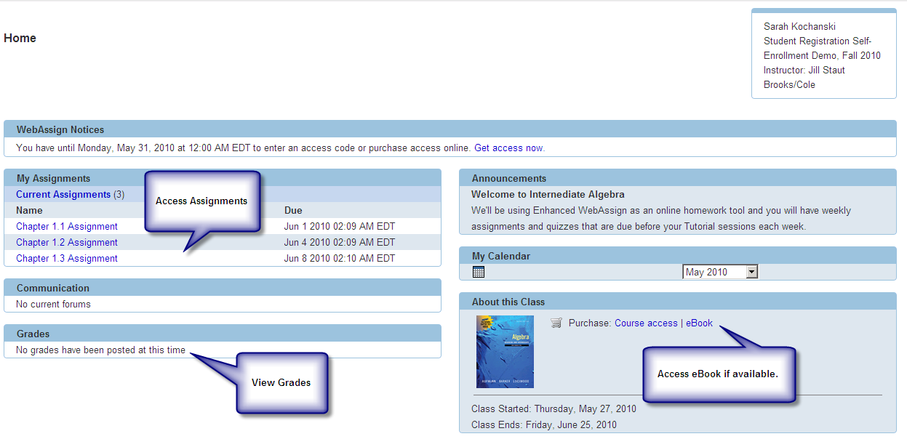
Your Home Page
Notes:
You’ll be taken to the student homepage where you can see a list of assignments, access your grades and the ebook for the course if you have purchased an access code which includes the eBook. You will also see class announcements and other communication options.
Additional resources like the Personalized Study Plan or Lecture Videos (available in some courses) will be available from this page as well.

Slide 11
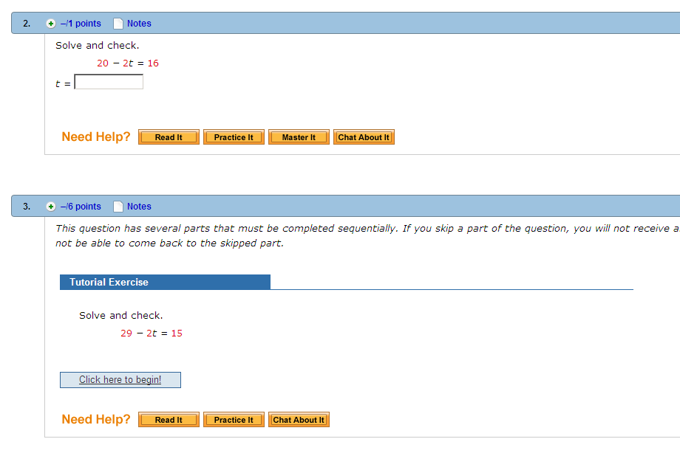
Homework Assignments
Notes:
This is just a sample of a homework assignment. (Feel free to include a screen shot of an actual assignment from your course).
As students are working problems they may have access to a variety of resources including:
Read It – Links to relevant textbook pages to support the problem they are working on
Practice IT – Interactive examples and similar drill problems (available in Developmental Math Only)
Watch It – Videos of Worked Examples
Master It – Stepped Tutorials
Chat About It – Access to a Live Tutor

Slide 12
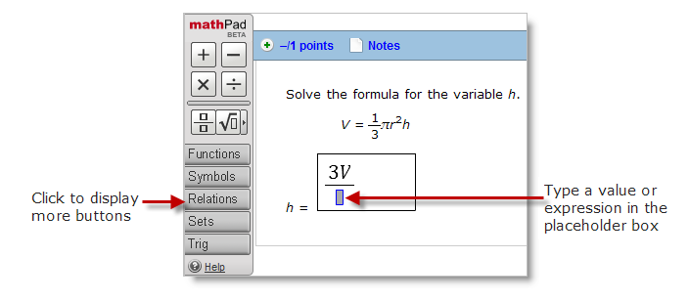
MathPad, Phys Pad, CalcPad
EWA includes entry palettes to allow you to easily enter the appropriate notation (when required) to submit your answers.
Notes:
EWA includes entry palettes to allow you to easily enter the appropriate notation (when required) to submit your answers.

Slide 13
Integrated eBook
Notes:
If you purchased a homework and eBook access card, you’ll have access to a digital version of your textbook complete with features that allow you to highlight passages and add notes or bookmarks which can be viewed at a later date. Additionally, there is full search capability and if you like you can even print off a few pages at a time to bring to class with you instead of lugging around your full textbook.
Many titles include a multimedia library with lecture videos, and other tutorial resources.

Slide 14
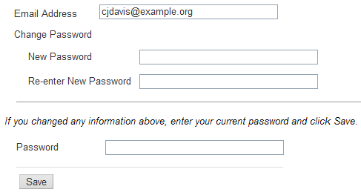
Resetting Your Password
Log in, then click My Options in the upper right corner.
Enter an email address if none is listed.
In Change Password, enter your new password, then re-enter your new password for confirmation.
Enter your current password in the lower left corner.
Click Save.
Notes:
Students should be encouraged to change their password on their first login.
Log in, then click My Options in the upper right corner.
Enter an email address if none is listed.
In Change Password, enter your new password, then re-enter your new password for confirmation.
Enter your current password in the lower left corner.
Click Save.

Slide 15
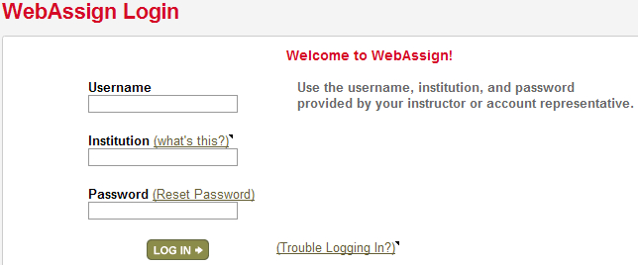
What if I forget my password?
Click Reset Password on the Login page.
You will need your username, institution code and the email address for your account.
Otherwise, your instructor is able to reset your password.
Notes:
If a student forgets their password and has an email address associated to their course, they can choose reset password from the login page.

Slide 16
Student Guide
Links to the WebAssign Student Guide are available on your Login page and after logging in.
The Student Guide explains:
How to access and open assignments.
How to answer various types of questions.
How to ask your teacher for help.
How to view scores and grades.
How to find additional resources.
Notes:
Links to the WebAssign Student Guide are available on your Login page and after logging in. The Student Guide explains:
How to access and open assignments.
How to answer various types of questions.
How to ask your teacher for help.
How to view scores and grades.
How to find additional resources.

Slide 17
Need Help ?
Phone support: (800) 955-8275, then press 1
E-mail support: student_help@webassign.net
See the WebAssign Support page at
www.webassign.net/user_support/student/
for support hours.

