Slide 1
Chapter 3 Non-Linear Functions and Applications Section 3.3

Slide 2
Section 3.3 Piecewise-Defined Functions
Definition and Graphs
Applications

Slide 3
What is a Piecewise-Defined Function?
A piecewise-defined function is one defined with different formulas for different parts of its domain.
The function is “divided in pieces” and will behave in a different manner based on the value of the input, (x).
Example:
For input values of x ≤ –2, we use the piece f(x) = |x + 5|.
For input values of x > –2, we use the piece f(x) = x² – 8.

Slide 4
Let
a. Find f(–7).
b. Find f(3).
a. f(–7) means to find the output when the input x = –7.
Since –7 < –2, we use the piece |x + 5| and evaluate it for x = – 7.
|–7 + 5| = |– 2| = 2
b. f(3) means to find the output when x = 3.
Since 3 > –2, we use the piece x² – 8 and evaluate it for x = 3.
(3)² – 8 = 9 – 8 = 1

Slide 5
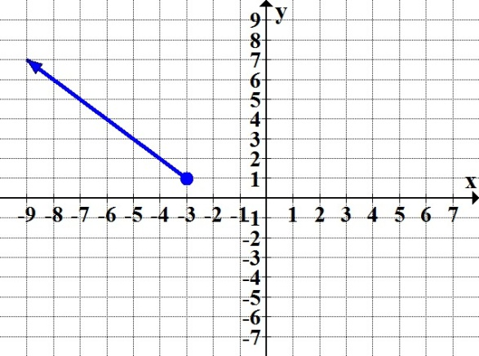
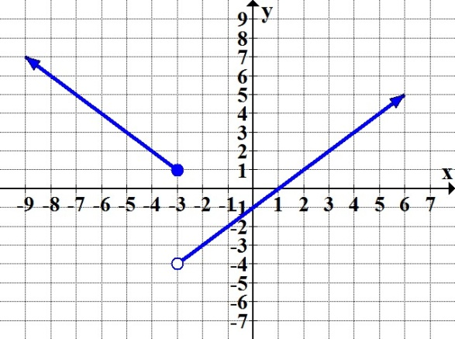
Graphing a Piecewise-Defined Function
We graph each piece individually, on its specific subdomain.
For values of x ≤ – 3 we graph
the piece y = |x + 3| + 1.
Then, for values of x > – 3, we
sketch the piece y = x – 1 on the
same coordinate plane.

Slide 6
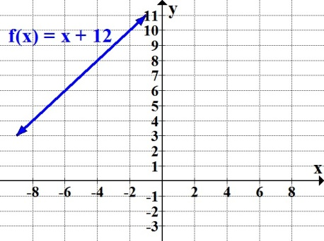
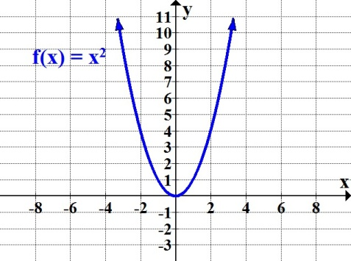
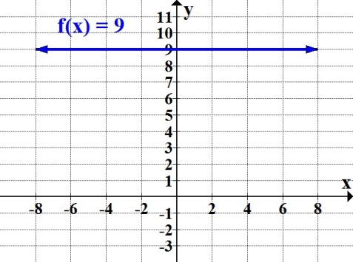
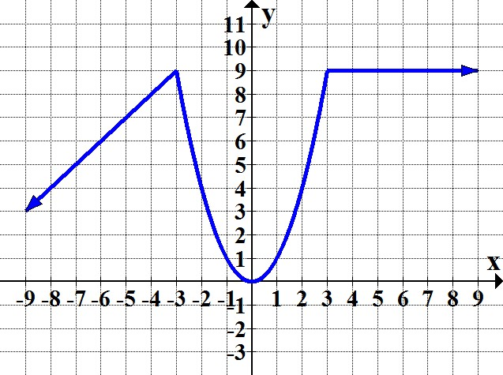
These would represent the graphs of each separate formula:
Sketching all three pieces applying the corresponding given subdomains, we obtain the graph of the piecewise-defined function:

Slide 7
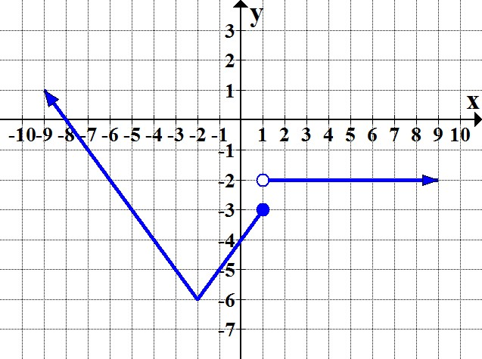
Find the piecewise-defined function whose graph is shown.

Slide 8
Markus is an administrative assistant. If he works up to 18 hours a week, he gets paid $14.75 an hour. If he works more than 18 hours to a maximum of 30 hours per week, Markus will receive $11.80 per hour plus a weekly bonus of $55.
Write a piecewise-defined function that represents the
weekly salary, S, for x hours of work.
Options for weekly salary:
0 ≤ hours ≤ 18 = 14.75 per hour
18 < hours ≤ 30 = 11.80 per hour + 55 bonus

Slide 9
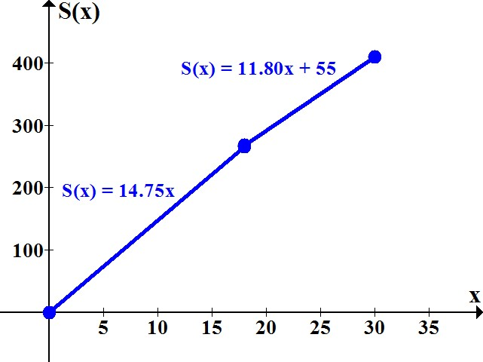
(Contd.)
Markus is an administrative assistant. If he works up to 18 hours a week, he gets paid $14.75 an hour. If he works more than 18 hours to a maximum of 30 hours per week, Markus will receive $11.80 per hour plus a weekly bonus of $55.
b. Graph the function.

Slide 10
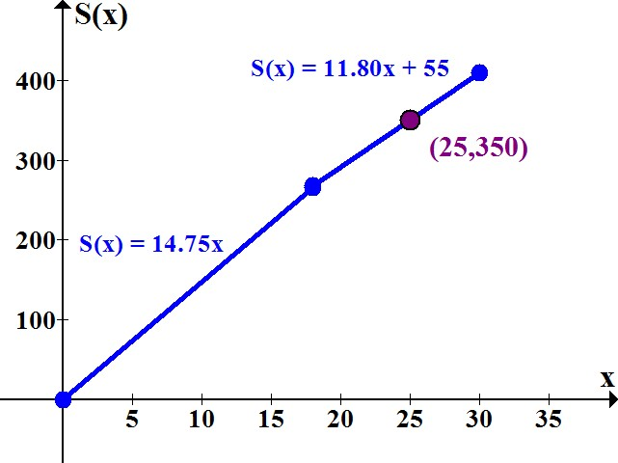
(Contd.)
c. How much will Markus earn if he works 25 hours? Find your answer algebraically and verify graphically.
For 25 hours, the second piece applies:
S(25) = 11.80(25) + 55 = $350

Slide 11
Using your textbook, practice the problems assigned by your instructor to review the concepts from Section 3.3.

