Slide 1
Chapter 3 Non-Linear Functions and Applications Section 3.2

Slide 2
Section 3.2 Transformations
Vertical and Horizontal Shifts
Reflections
Stretching and Compressing Graphs of Functions
Combining Multiple Transformations to Sketch a Graph
Average Rate of Change
The Difference Quotient

Slide 3
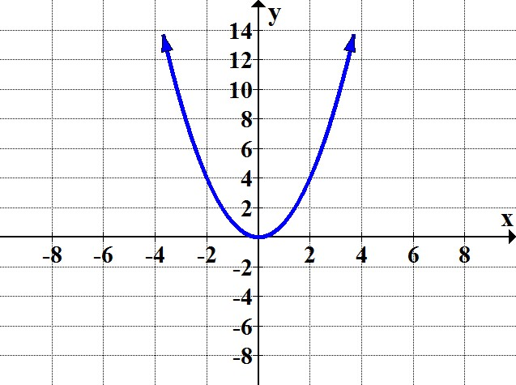
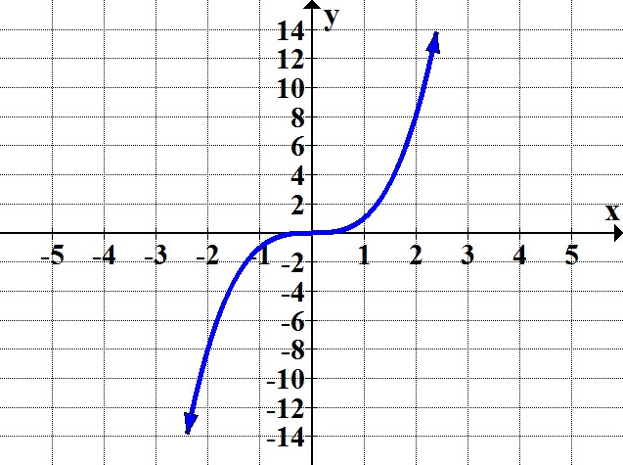
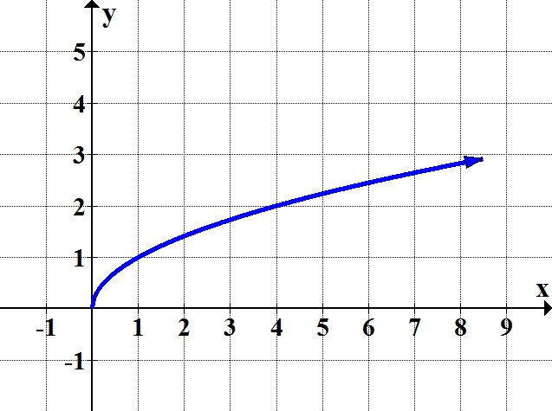
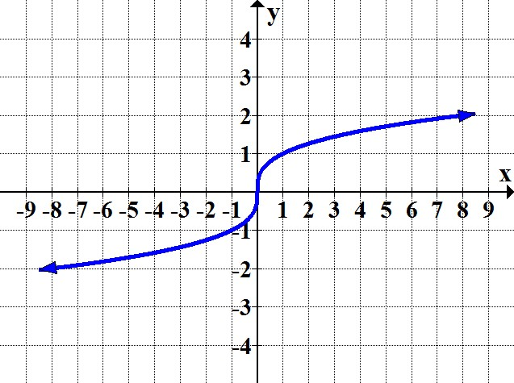
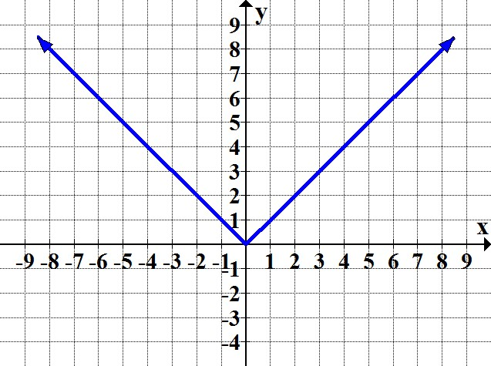
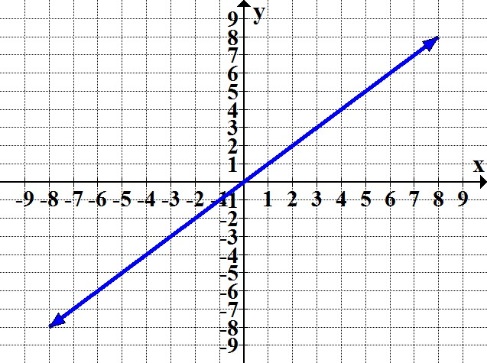
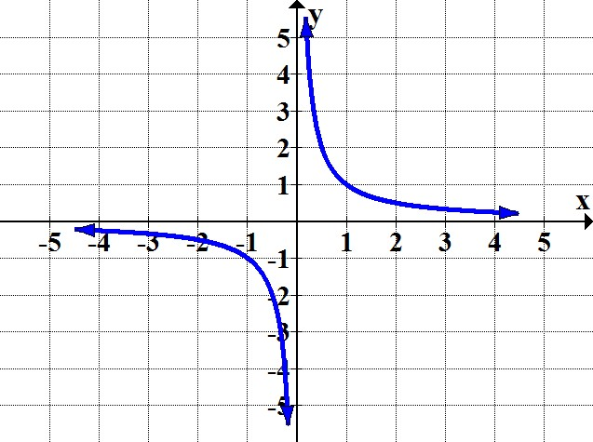
Review of 7 Basic Functions
Square Cube Square Root
f(x) = x² f(x) = x³ f(x) =
Cube Root Absolute Value Identity
f(x) = f(x) = f(x) = x
Reciprocal
f(x) =

Slide 4
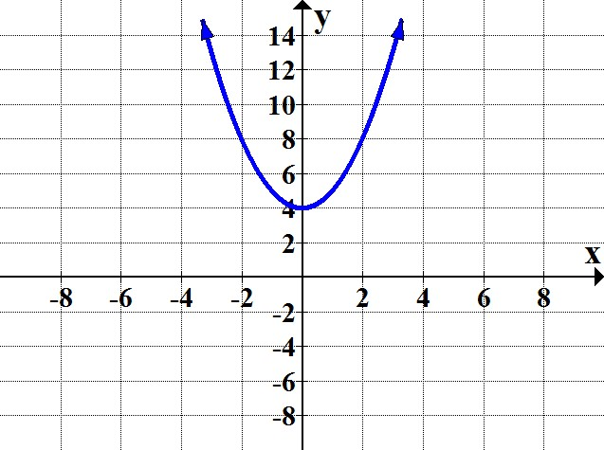
Vertical Shifts (Up)
For a function y = f(x) and c > 0:
The graph of y = f(x) + c is equivalent to the graph of f(x) shifted upward c units.
Example:
f(x) = x² f(x) = x² + 4

Slide 5
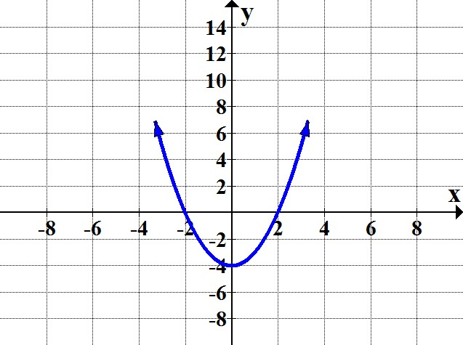
Vertical Shifts (Down)
For a function y = f(x) and c > 0:
The graph of y = f(x) – c is equivalent to the graph of f(x) shifted downward c units.
Example:
f(x) = x² f(x) = x² – 4

Slide 6
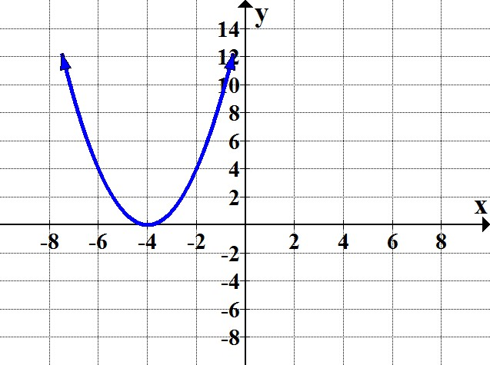
Horizontal Shifts (left)
For a function y = f(x) and c > 0:
The graph of y = f(x + c) is equivalent to the graph of f(x) shifted left c units.
Example:
f(x) = x² f(x) = (x + 4)²

Slide 7
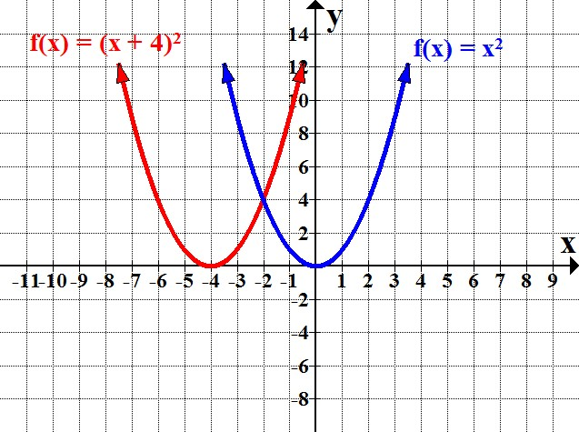
Horizontal Shifts: If y = f(x + c), why shift left?
Examine a table of values for each function:
Notice that every point on the graph of f(x) = (x + 4)² is 4 units to the left of a corresponding point on the graph of f(x) = x².
x | –4 | –3 | –2 | –1 | 0 | 1 | 2
f(x) = x² | 16 | 9 | 4 | 1 | 0 | 1 | 4
x | –4 | –3 | –2 | –1 | 0 | 1 | 2
f(x) = (x + 4)² | 0 | 1 | 4 | 9 | 16 | 25 | 36

Slide 8
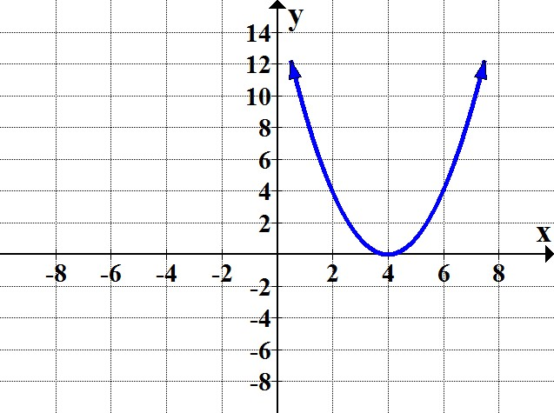
Horizontal Shifts (right)
For a function y = f(x) and c > 0:
The graph of y = f(x – c) is equivalent to the graph of f(x) shifted right c units.
Example:
f(x) = x² f(x) = (x – 4)²

Slide 9
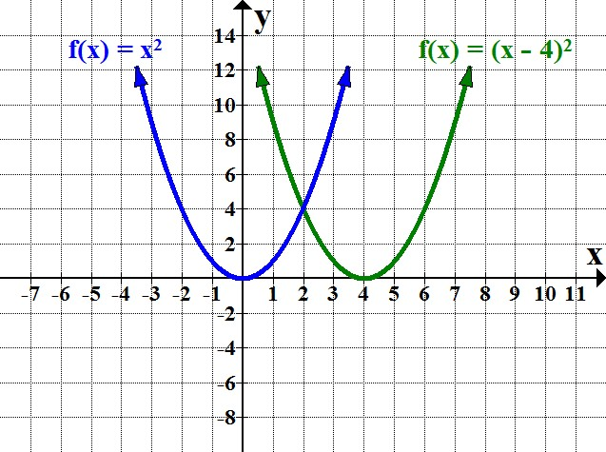
Horizontal Shifts: If y = f(x – c), why shift right?
Examine a table of values for each function:
Observe that every point on the graph of f(x) = (x – 4)² is 4 units to the right of a corresponding point on the graph of f(x) = x².
x | –4 | –3 | –2 | –1 | 0 | 1 | 2
f(x) = x² | 16 | 9 | 4 | 1 | 0 | 1 | 4
x | –4 | –3 | –2 | –1 | 0 | 1 | 2
f(x) = (x – 4)² | 64 | 49 | 36 | 25 | 16 | 9 | 4

Slide 10
Summary of Vertical and Horizontal Translations
The location of the graph of the function is changed, but the size
and shape of the graph is not changed.
Vertical shifts: Adding or subtracting “outside” the function
Horizontal shifts: Adding or subtracting “inside” the function
f(x) + c | Shift graph of f(x) upward c units
f(x) − c | Shift graph of f(x) downward c units
f(x + c) | Shift graph of f(x) left c units
f(x − c) | Shift graph of f(x) right c units

Slide 11
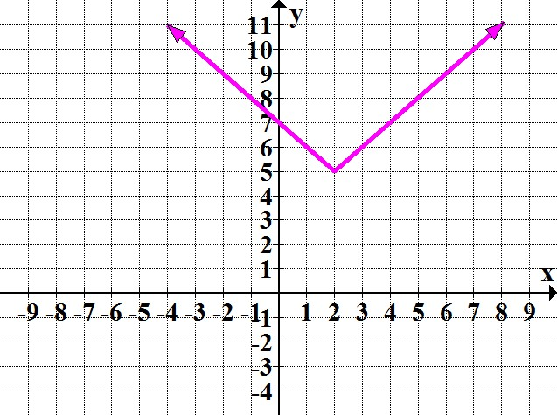
Vertical and Horizontal Translations
Example:
f(x) = |x – 2| + 5
inside outside
move opposite direction move same direction
“2 units right, 5 units up”
f(x) = |x| f(x) = |x – 2| + 5

Slide 12
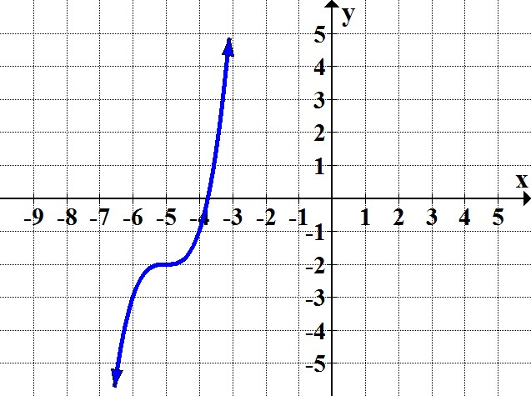
Identify the following graph as a translation of one of the basic functions, and write the equation for the graph.
This is the graph of f(x) = x³ shifted left 5 units and down 2 units.
f(x) = (x + 5)³ – 2

Slide 13
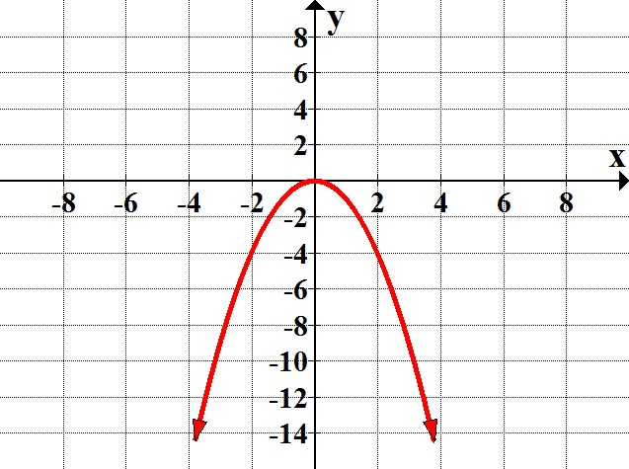
Reflections about the x-axis
The graph of y = –f(x) is obtained by reflecting the graph of
y = f(x) with respect to the x-axis.
Example:
f(x) = x² f(x) = –x²

Slide 14
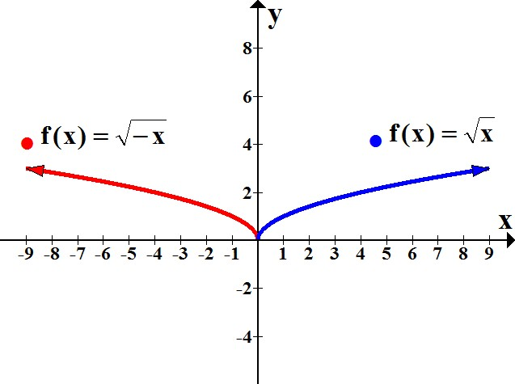
Reflections about the y-axis
The graph of y = f(–x) is obtained by reflecting the graph of
y = f(x) with respect to the y-axis.
Example:

Slide 15
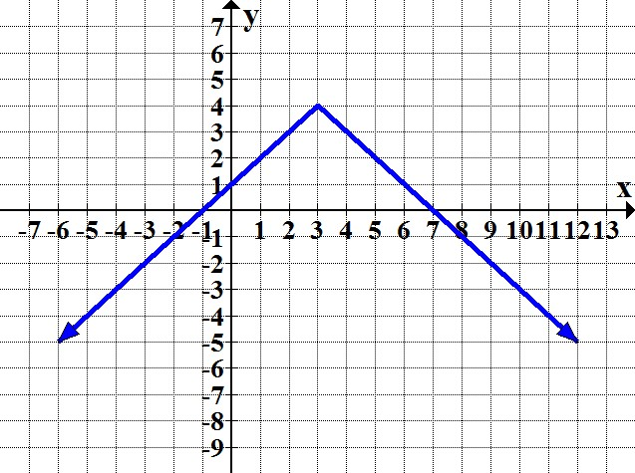
Given the graph below, (a) state the basic function, (b) describe the transformations applied, and (c) write the equation for the given graph.
a.
Reflection about the x-axis
Horizontal shift: 3 units right
Vertical shift: 4 units upward
c.

Slide 16
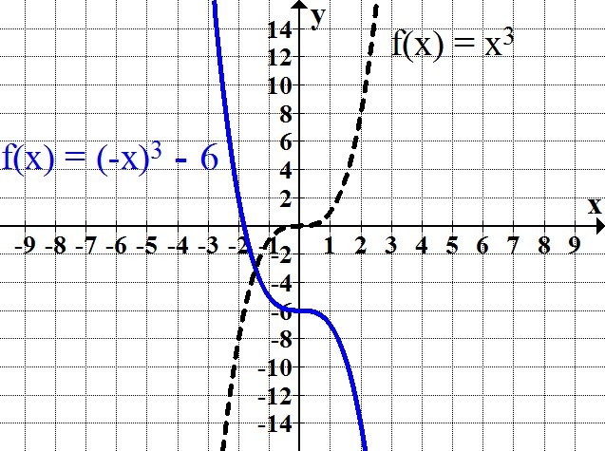
Use the corresponding basic function to construct the graph of the function f(x) = (–x)³ – 6.
The basic function is f(x) = x^{3.}
Transformations in f(x) = (–x)³ – 6:
Reflection about the y-axis
Vertical shift of 6 units downward

Slide 17
Stretching and Compressing
Let c be a constant. The graph of y = cf(x) is obtained by vertically stretching or compressing the graph of
y = f(x).
If |c| > 1, the graph will be vertically stretched by a factor of c.
If 0 < |c| < 1, the graph will be vertically compressed by a factor of c.

Slide 18
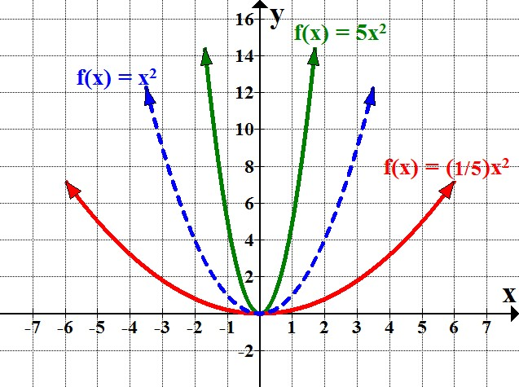
Stretching and Compressing
Example:
In f(x) = 5x², stretching “elongates” the graph; the transformed graph appears "narrower" than the graph of
f(x) = x².
In f(x) = (1/5)x², compressing “flattens” the graph; the transformed graph appears "wider" than the graph of
f(x) = x².

Slide 19
Combining Multiple Transformations
to Sketch a Graph
In general, it may be useful to use the following order:
1. Reflection
2. Vertical stretch or compression
3. Horizontal shift
4. Vertical shift
Other possible ordering will produce the same result, but do the vertical shift last.

Slide 20
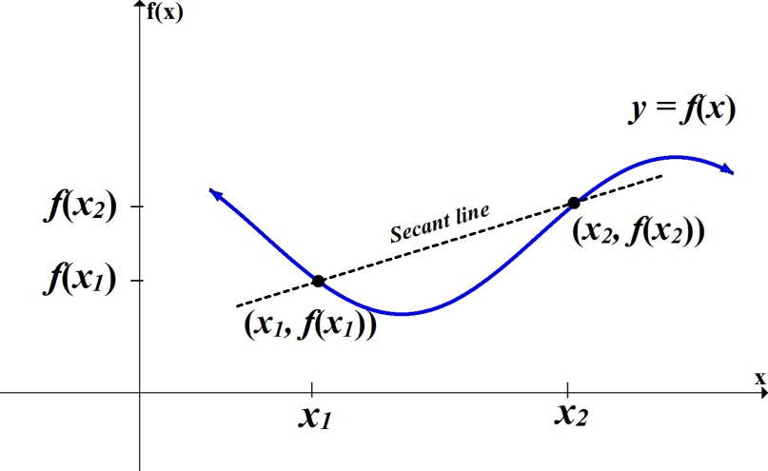
Average Rate of Change
Let f be a function. Let (x₁, f(x₁)) and (x₂, f(x₂)) represent two distinct points on the graph of f, where x₁ ≠ x₂.
The average rate of change of f between x₁ and x₂ is given by

Slide 21
Let x represent a test number, and y equal a test score. Assume a student obtains a test 1 score of 76 and a score
of 92 on test 3. Find the average rate of change from test 1 to test 3.
Given the points (1, 76) and (3, 92) we find the average rate of change by calculating:

Slide 22
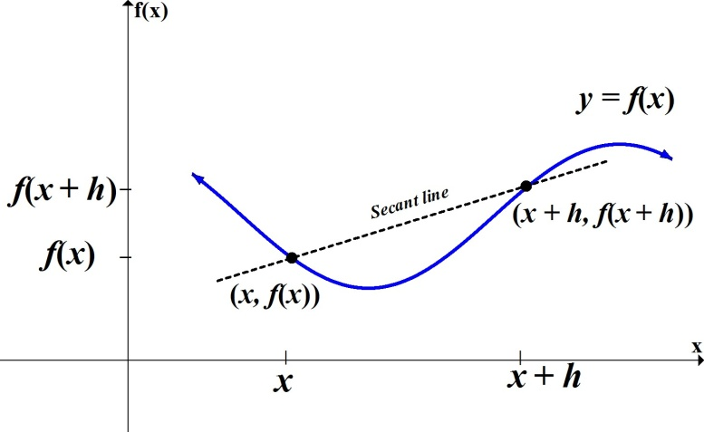
The Difference Quotient
Let f be a function and h a nonzero constant. Let (x, f(x)) and (x + h, f(x + h)) represent two distinct points on the graph of f.
The average rate of change of f between x and x + h is the difference quotient, given by
Notice that the main operations involved in the "difference quotient" are subtraction (difference) and division (quotient).

Slide 23
Find the difference quotient for f(x) = 3x² – x.
Before we apply the formula
it is recommended to first find f(x + h):
Caution: (x + h)² ≠ x² + h²
Recall (x + h)² = (x + h)(x + h) = x² + 2xh + h²
(continued on the next slide)

Slide 24
Now we find the difference quotient:

Slide 25
Using your textbook, practice the problems assigned by your instructor to review the concepts from Section 3.2.

