Slide 1

Chapter 3
Non-Linear Functions and Applications
Section 3.1

Slide 2

Section 3.1
Basic Functions and Their Graphs
Basic Functions: Square, Cube, Square Root, Cube Root,
Absolute Value, Reciprocal, Identity
Graphing Basic Functions with the Graphing Calculator
Function Symmetry: Even and Odd Functions
Finding Relative Maximum and Relative Minimum Values
Finding Zeros of a Function Graphically

Slide 3

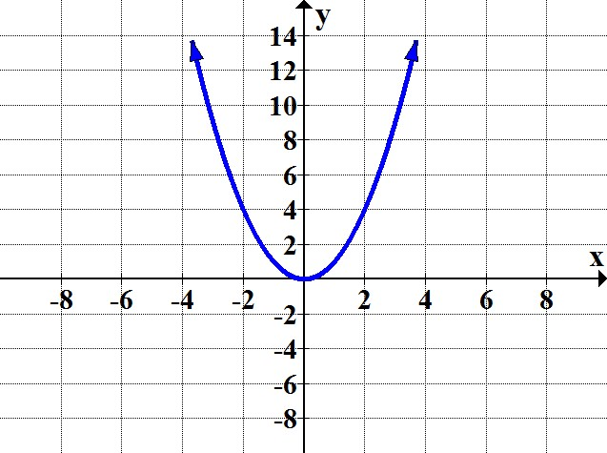
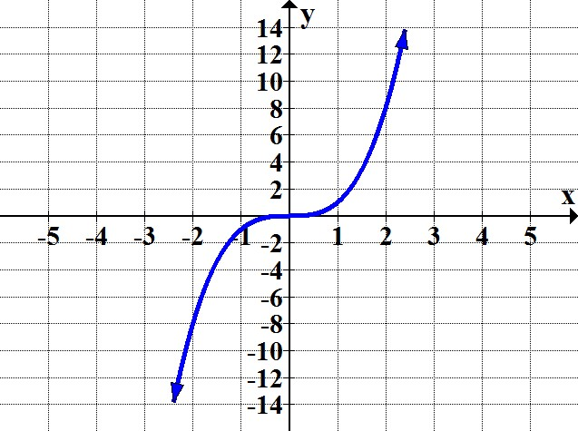
Square Function: f(x) = x²
Domain: (–∞, ∞)
Range: [0, ∞)
Cube Function: f(x) = x³
Domain: (–∞, ∞)
Range: (–∞, ∞)

Slide 4
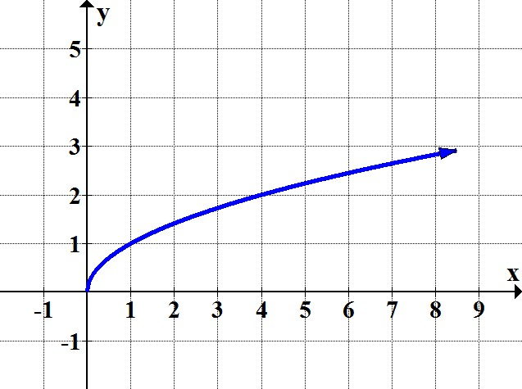
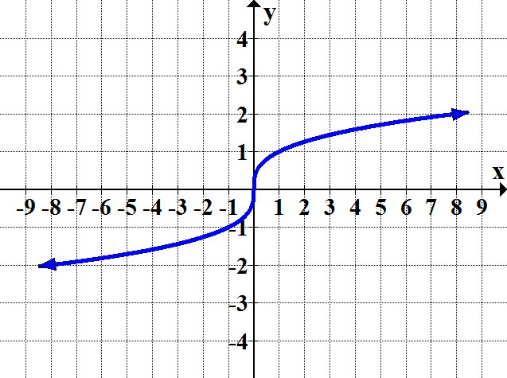
Square Root Function: f(x) =
Domain: [0, ∞)
Range: [0, ∞)
Cube Root Function: f(x) =
Domain: (–∞, ∞)
Range: (–∞, ∞)

Slide 5
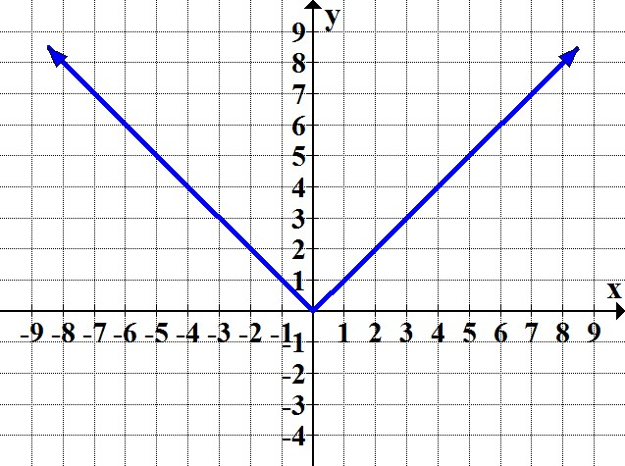
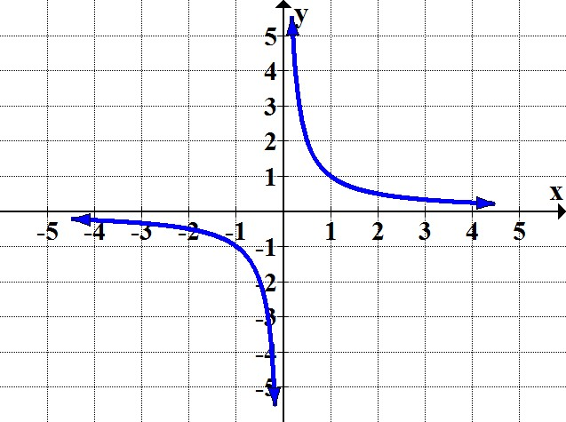
Absolute Value Function: f(x) =
Domain: (–∞, ∞)
Range: [0, ∞)
Reciprocal Function: f(x) =
Domain: (–∞, 0) U (0, ∞)
Range: (–∞, 0) U (0, ∞)

Slide 6
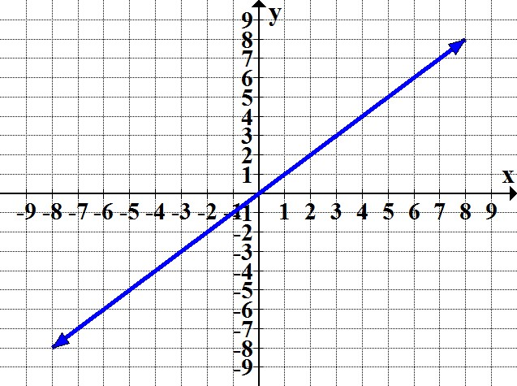
Identity Function: f(x) = x
Domain: (–∞, ∞)
Range: (–∞, ∞)

Slide 7
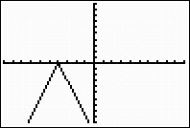
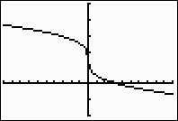
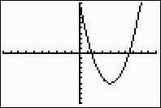
Each of the following graphs is a family member of one of the basic functions. Determine the basic function in each case.
a. b. c.
a. Absolute function
b. Cube root function
c. Square function (also known as “Parabola”)

Slide 8
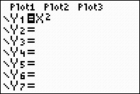
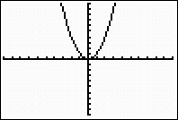
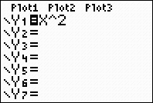
Graphing Basic Functions with Graphing Calculator
Square Function: f(x) = x²
Two options:
✓Use the default square key: q
Keystrokes: ! x q %
✓Use the exponential key: ^
Keystrokes: ! x ^ 2 %

Slide 9

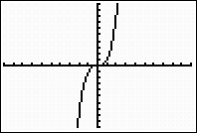
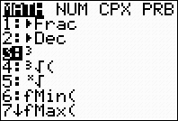

Cube Function: f(x) = x³
Two options:
✓Use the exponential key: ^
Keystrokes: ! x ^ 3 %
✓Use the math menu key: m
Keystrokes: ! x m 3 %

Slide 10
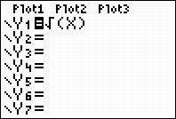
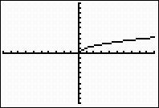
Square Root Function: f(x) =
✓Use the square root key: ¢ (found above the q key)
Keystrokes: ! ` ¢ x ) %
Note: Most probably, the calculator will display a parenthesis in front of x; if so, be sure to close the parenthesis.

Slide 11
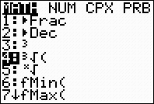
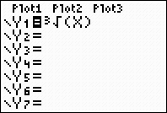
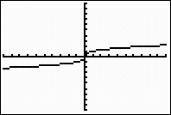
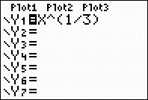
Cube Root Function: f(x) =
Two options:
✓Use the math menu key: m
Keystrokes: !g g m 4 x ) %
Note: Most probably, the calculator will display a parenthesis in front of x; if so, be sure to close the parenthesis.
✓Recall:
Use the rational exponent form, with exponential key: ^
Keystrokes: ! x ^ ( 1 / 3 ) %

Slide 12
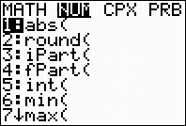
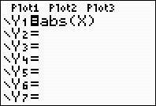
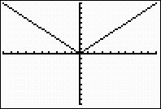

Absolute Value Function: f(x) =
Two options:
✓Use the math menu key: m
Keystrokes: !g g m > [NUM] 1 x ) %
Note: Most probably, the calculator will display a parenthesis in front of x; if so, be sure to close the parenthesis.
✓Use the catalog key: [abs] (found above the 0 key)
Keystrokes: ! ` ≠ e x g ) %

Slide 13

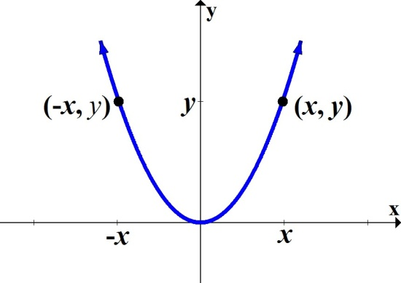
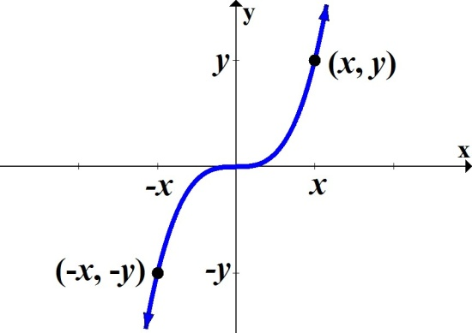
Even and Odd Functions
Even Function: Graph is symmetric about the y-axis.
If (x, y) is a point on the graph, then (–x, y) is also a point on
the graph.
Example:
Odd Function: Graph is symmetric about the origin.
If (x, y) is a point on the graph, then (–x, –y) is also a point on
the graph.
Example:

Slide 14
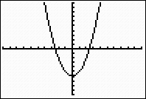
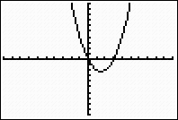
Algebraic Test for Even Function
f(–x) = f(x)
(Replacing x with –x results in the same function.)
a. Determine if f(x) = x² – 6 is an even function.
f(-x) = (–x)² – 6
= x² – 6
Since f(–x) = f(x), this is an even function.
Observe graph is symmetric about the y-axis:
b. Determine if f(x) = x² – 3x is an even function.
f(–x) = (–x)² – 3(–x)
= x² + 3x
Since f(–x) ≠ f(x), this is not an even function.
Graph is not symmetric about the y-axis:

Slide 15
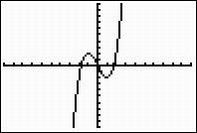
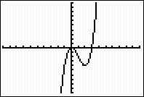
Algebraic Test for Odd Function
f(–x) = –f(x)
(Replacing x with –x gives the negative of the original function.)
a. Determine if f(x) = x³ – 3x is an odd function.
f(–x) = (–x)³ – 3(–x)
= –x³ + 3x
Since f(–x) = –f(x), this is an odd function.
Observe graph is symmetric about the origin:
b. Determine if f(x) = x³ – 3x² is an odd function.
f(–x) = (–x)³ – 3(–x)²
= –x³ – 3x²
Since f(–x) ≠ –f(x), this is not an odd function.
Graph is not symmetric about the origin:

Slide 16
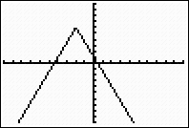
Global or Absolute Maximum of a Function
Highest point over the entire domain of a function.
Global or Absolute Minimum of a Function
Lowest point over the entire domain of a function.

Slide 17
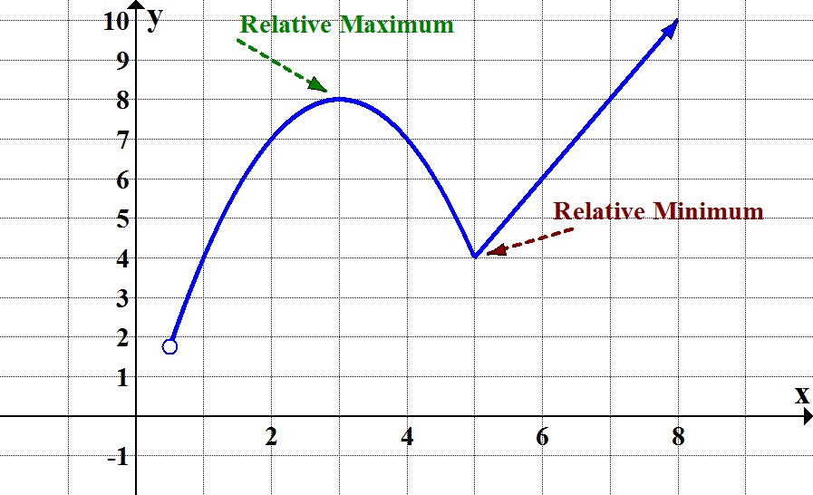
Relative Maximum and Relative Minimum
Turning Points: Where a graph of a function changes
behavior from increasing to decreasing or vice versa;
highest or lowest points at specific intervals of the graph.
Each turning point is called a Relative (or local) Maximum or
a Relative (or local) Minimum.

Slide 18
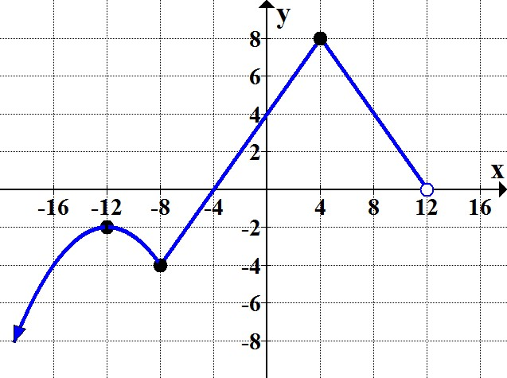
Given the graph of a function below, answer the questions.
At what value of x is the relative minimum occurring?
The graph has a turning point where it changes its behavior
from a decreasing interval to an increasing interval, when x = –8.
Therefore, this function has a relative minimum at x = –8.
What is the relative minimum?
The relative minimum is the output of the function at x = –8, or
f(–8) = –4.
The relative minimum in ordered pair form would be (–8, –4).

Slide 19
(Contd.)
For what values of x does the function have relative maxima?
The graph has two turning points where it changes its behavior
from an increasing interval to a decreasing interval at x-values
of –12 and 4.
This function has relative maxima at x = –12 and at x = 4.
What are the relative maxima?
The relative maxima are f(–12) = –2 and f(4) = 8.

Slide 20
(Contd.)
State any absolute maximum or minimum on this graph.
The highest point over the entire domain of the function is the
point (4, 8).
The function will have an absolute maximum of 8 at x = 4.
There is no absolute minimum.

Slide 21
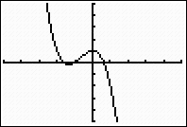
Relative Maximum and Relative Minimum
with the Graphing Calculator
Next, we show how to find the relative minimum and relative
maximum values for the function f(x) = –x³ – 2x² + 1, using the
graphing calculator. Window used: [–5, 5, 1] by [–5, 5, 1]
Relative Maximum
Relative Minimum
(continued on the next slide)

Slide 22
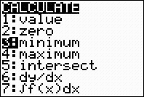
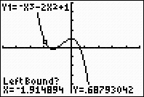
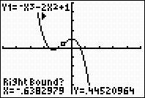
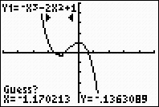
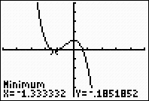
Relative Minimum:
Use option 3 from the Calculate menu.
Keystrokes: ` g $ 3
Left Bound? Move the cursor near and
to the left of the minimum point; press e.
Right Bound? Move the cursor near and
to the right of the minimum point; press e.
Guess? Move the cursor as close as
possible to the minimum point; press e.
The calculator will display the coordinates of the relative minimum.

Slide 23
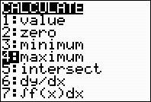
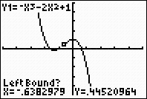
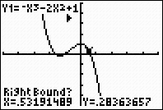
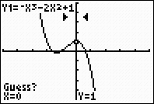
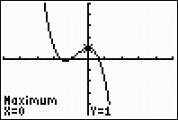
Relative Maximum:
Use option 4 from the Calculate menu.
Keystrokes: ` g $ 4 g
Left Bound? Move the cursor near and
to the left of the maximum point; press e.
Right Bound? Move the cursor near and
to the right of the maximum point; press e.
Guess? Move the cursor as close as
possible to the maximum point; press e.
The calculator will display the coordinates of the relative maximum.

Slide 24
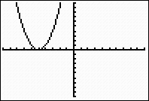
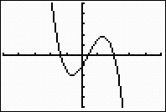
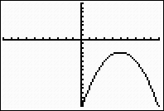
Zeros of a Function
The x-intercept of the graph of a function is also called
the zero of the function.
A function can have no zero, one zero, or multiple zeros.
One zero Three zeros No zero

Slide 25
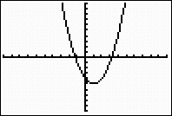
Finding Zeros of a Function with the Graphing Calculator
Next, we show how to find the zeros of the function
f(x) = (x – 1)² – 5, using the graphing calculator.
Window used: [–10, 10, 1] by [–10, 10, 1]
(continued on the next slide)

Slide 26
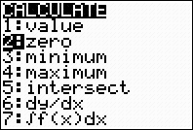
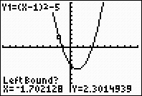



Finding the Zero:
Use option 2 from the Calculate menu.
Keystrokes: ` g $ 2
Left Bound? Move the cursor near and
to the left of the zero; press e.
Right Bound? Move the cursor near and
to the right of the zero; press e.
Guess? Move the cursor as close as
possible to the zero; press e.
The calculator will display the coordinates
of the leftmost zero. (Repeat the sequence
to find the rightmost zero.)

Slide 27

Using your textbook, practice the problems assigned by your instructor to review the concepts from Section 3.1.

